Slide 1
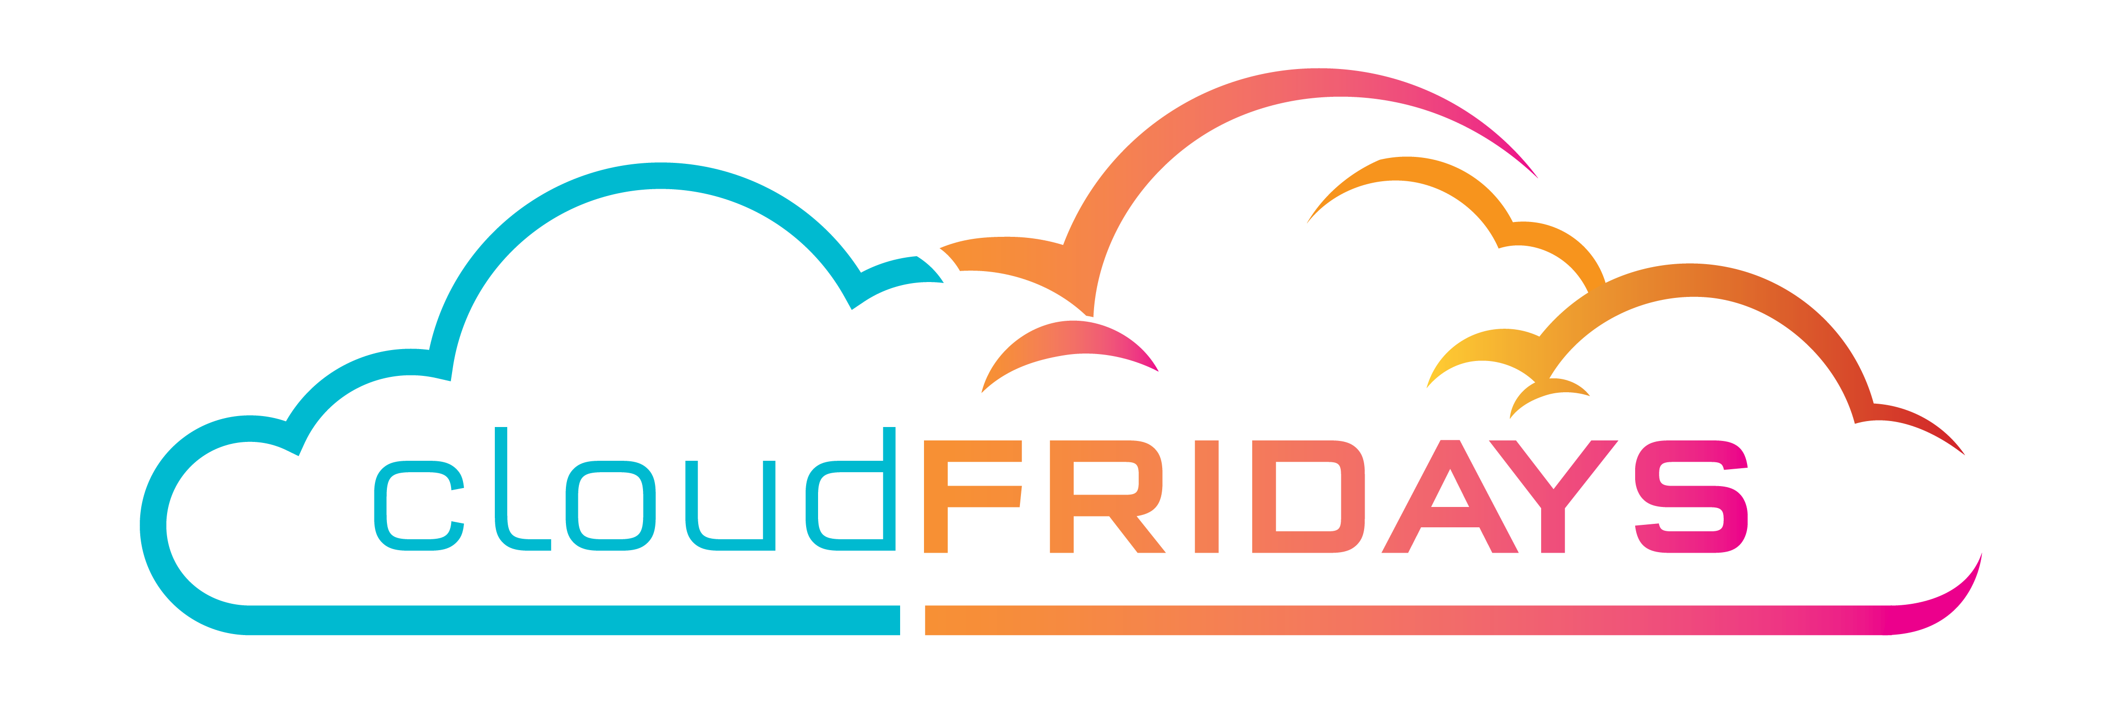

Azure Core Products
Warren du Toit
Azure and OAS MVP
@warrendt

Slide 2
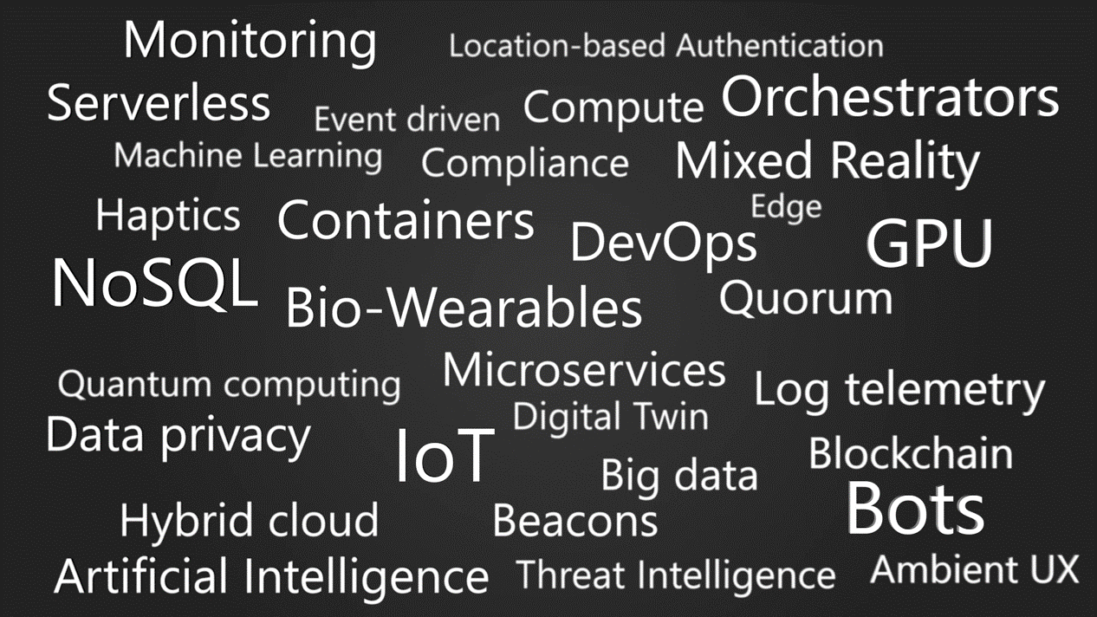
Notes:
Because of the cloud, it is an amazing time to be working with technology
Because of the cloud, we are able to innovate and release new technologies at a pace we have never been able to do before
New product features are developed in short sprints and rolled out globally instead of our old ‘version release’ model which could take years
Here are a few of the exciting technologies available because of the cloud, because of the pace of innovation
This is exciting but can also be overwhelming. So, what do we do with all of this technology?

Slide 3
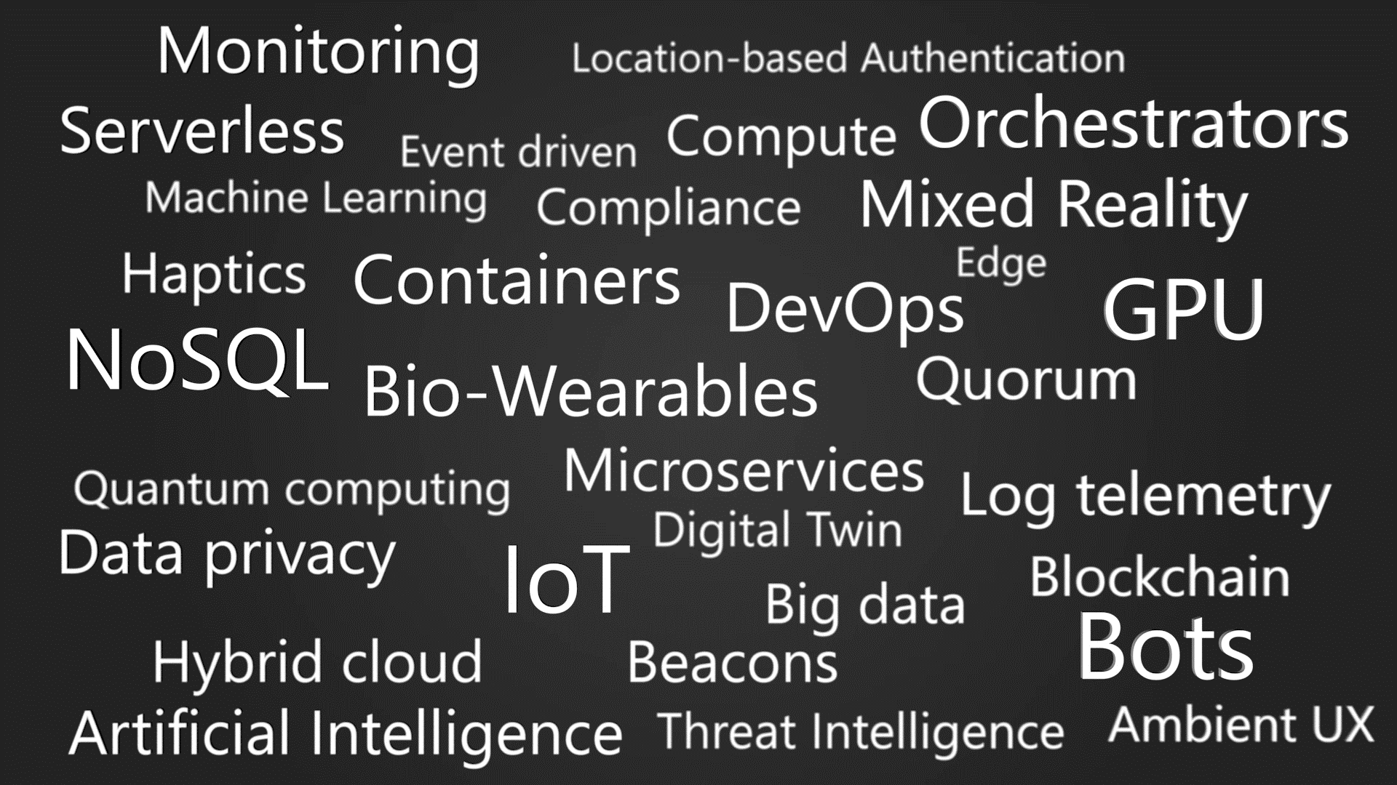
Notes:
It’s an amazing time in technology because of the cloud
Because of the cloud, we are able to innovate and release new technologies at a pace we have never been able to do before
New product features are developed in short sprints and rolled out globally instead of our old ‘version release’ model which could take years
Here are a few of the exciting technologies available because of the cloud, because of the pace of innovation
This is exciting but can also be overwhelming.

Slide 4
Dive into Azure Products

Slide 5
Azure products
AI + Machine Learning
Management Tools
Analytics
Media
Compute
Microsoft Azure Stack
Containers
Migration
Databases
Mobile
Developer Tools
Networking
DevOps
Security
Identity
Storage
Integration
Web
Internet of Things

Slide 6
Azure products
AI + Machine Learning
Management Tools
AI + Machine Learning
Create the next generation of applications using artificial intelligence capabilities for any developer and any scenario
Analytics
Media
Compute
Microsoft Azure Stack
Cognitive Services Add smart API capabilities to enable contextual interactions | Azure Bot Service Intelligent, serverless bot service that scales on demand
Azure Databricks Fast, easy, and collaborative Apache Spark- based analytics platform | Machine Learning Open and elastic AI development spanning the cloud and the edge
Cognitive Services – Search APIs Harness the ability to comb billions of webpages, mages, videos, and news with a single API call | Cognitive Services – Language APIs Process natural language with pre-built scripts, evaluate sentiment, and learn to recognize intent
Cognitive Services – Vision APIs Use Image-processing algorithms to smartly identify, caption and moderate your pictures | Cognitive Services – Speech APIs Convert speech to text or text to speech, translate text or audio, or add speaker recognitions to your app
Cognitive Services – Knowledge APIs Map information and data in order to solve complex tasks
Containers
Migration
Databases
Mobile
Developer Tools
Networking
DevOps
Security
Identity
Storage
Integration
Web
Internet of Things
* Preview Services
http://azureplatform.azurewebsites.net/

Slide 7
Azure products
AI + Machine Learning
Management Tools
Analytics
Gather, store, process, analyze, and visualize data of any variety, volume, or velocity
Analytics
Media
Compute
Microsoft Azure Stack
SQL Data Warehouse Elastic data warehouse as a service with enterprise-class features | Azure Databricks Fast, easy, and collaborative Apache Spark-based analytics platform
HDInsight Provision cloud Hadoop, Spark, R Server, Hbase, and Storm clusters | Data Factory Hybrid data integration at enterprise scale, made easy
Machine Learning Open and elastic AI development spanning the cloud and the edge | Stream Analytics Real-time data stream processing from millions of IoT devices
Data Lake Analytics Distributed analytics service that makes big data easy | Azure Analysis Services Enterprise-grade analytics engine as a service
Event Hubs Receive telemetry from millions of devices
Containers
Migration
Databases
Mobile
Developer Tools
Networking
DevOps
Security
Identity
Storage
Integration
Web
Internet of Things
* Preview Services
http://azureplatform.azurewebsites.net/

Slide 8
Azure products
AI + Machine Learning
Management Tools
Compute
Access cloud compute capacity and scale on demand—and only pay for the resources you use
Analytics
Media
Compute
Microsoft Azure Stack
Virtual Machines Provision Windows and Linux virtual machines in seconds | Virtual Machine Scale Sets Manage and scale up to thousands of Linux and Windows virtual machines
Azure Kubernetes Service (AKS) Simplify the deployment, management, and operations of Kubernetes | Functions Process events with serverless code
Service Fabric Develop microservices and orchestrate containers on Windows or Linux | App Service Quickly create powerful cloud apps for web and mobile
Container Instances Easily run containers with a single command | Batch Cloud-scale job scheduling and compute management
Azure Batch AI Easily experiment and train your deep learning and AI models in parallel at scale
Containers
Migration
Databases
Mobile
Developer Tools
Networking
DevOps
Security
Identity
Storage
Integration
Web
Internet of Things
* Preview Services
http://azureplatform.azurewebsites.net/

Slide 9
Azure products
AI + Machine Learning
Management Tools
Containers
Develop and manage your containerized applications faster with integrated tools
Analytics
Media
Compute
Microsoft Azure Stack
Azure Kubernetes Service (AKS) Simplify the deployment, management, and operations of Kubernetes | Container Instance Easily run containers with a single command
Service Fabric Develop microservices and orchestrate containers on Windows or Linux | Container Registry Store and manage container images across all types of Azure deployments
App Service Quickly create powerful cloud apps for web and mobile | Web App for Containers Easily deploy and run containerized web apps that scale with your business
Batch Cloud-scale job scheduling and compute management
Containers
Migration
Databases
Mobile
Developer Tools
Networking
DevOps
Security
Identity
Storage
Integration
Web
Internet of Things
* Preview Services
http://azureplatform.azurewebsites.net/

Slide 10
Azure products
AI + Machine Learning
Management Tools
Databases
Support rapid growth and innovate faster with secure, enterprise-grade, and fully managed database services
Analytics
Media
Compute
Microsoft Azure Stack
Azure Cosmos DB Globally distributed, multi-model database for any scale | Azure SQL Database Managed relational SQL Database as a service
Azure Database for MySQL Managed MySQL database service for app developers | Azure Database for PostgreSQL Manage PostgreSQL database service for app developers
SQL Server ono Virtual Machines Host enterprise SQL Server apps in the cloud | SQL Data Warehouse Elastic data warehouse as a service with enterprise- class features
Azure Database Migration Service Simplify on-premises database migration to the cloud | Redis Cache Power applications with high-throughput, low latency data access
SQL Server Stretch Database Dynamically stretch on-premises SQL Server databases to Azure
Containers
Migration
Databases
Mobile
Developer Tools
Networking
DevOps
Security
Identity
Storage
Integration
Web
Internet of Things
* Preview Services
http://azureplatform.azurewebsites.net/

Slide 11
Azure products
AI + Machine Learning
Management Tools
Developer Tools
Build, manage, and continuously deliver cloud applications—using any platform or language
Analytics
Media
Compute
Microsoft Azure Stack
Visual Studio The powerful and flexible environment for developing applications in the cloud | Visual Studio Code A powerful, lightweight code editor for cloud development
SDKs Get the SDKs and command-line tools you need | Developer tools integrations Use the development tools you know—including Eclipse, IntelliJ, and Maven—with Azure
CLIs Build, deploy, diagnose, and manage multi-platform, scalable apps and services | Azure DevOps Services Services for teams to share code, track work, and ship software
Azure Lab Services Set up labs for classrooms, trials, development and testing, and other scenarios | Azure DevTest Labs Quickly create environments using reusable templates and artifacts
Containers
Migration
Databases
Mobile
Developer Tools
Networking
DevOps
Security
Identity
Storage
Integration
Web
Internet of Things
* Preview Services
http://azureplatform.azurewebsites.net/

Slide 12
Azure products
AI + Machine Learning
Management Tools
DevOps
Deliver innovation faster with simple, reliable tools for continuous delivery
Analytics
Media
Compute
Microsoft Azure Stack
Azure DevOps Projects Build any Azure application, on any Azure service, in less than five minutes | Azure DevOps Services Services for teams to share code, track work, and ship software
DevOps tool integrations Use your favorite DevOps tools with Azure | Visual Studio App Center Ship apps faster by automating application lifecycles
Application Insights Detect, triage, and diagnose issues in your web apps and services | Azure Lab Services Set up labs for classrooms, trials, development and testing, and other scenarios
Azure DevTest Labs Quickly create environments using reusable templates and artifacts
Containers
Migration
Databases
Mobile
Developer Tools
Networking
DevOps
Security
Identity
Storage
Integration
Web
Internet of Things
* Preview Services
http://azureplatform.azurewebsites.net/

Slide 13
Azure products
AI + Machine Learning
Management Tools
Identity
Manage user identities and access to protect against advanced threats across devices, data, apps, and infrastructure
Analytics
Media
Compute
Microsoft Azure Stack
Azure Active Directory Synchronize on-premises directories and enable single sign-on | Azure Active Directory B2C Consumer identity and access management in the cloud
Azure Active Directory Domain Services Join Azure virtual machines to a domain without domain controllers | Multi-Factor Authentication Add security for your data and apps without adding hassles for users
Azure Information Protection Better protect your sensitive information— anytime, anywhere
Containers
Migration
Databases
Mobile
Developer Tools
Networking
DevOps
Security
Identity
Storage
Integration
Web
Internet of Things
* Preview Services
http://azureplatform.azurewebsites.net/

Slide 14
Azure products
AI + Machine Learning
Management Tools
Integration
Seamlessly integrate on-premises and cloud-based applications, data, and processes across your enterprise
Analytics
Media
Compute
Microsoft Azure Stack
Logic Apps Automate the access and use of data across clouds without writing code | Service Bus Connect across private and public cloud environments
API Management Publish APIs to developers, partners, and employees securely and at scale | Event Grid Get reliable event delivery at massive scale
Containers
Migration
Databases
Mobile
Developer Tools
Networking
DevOps
Security
Identity
Storage
Integration
Web
Internet of Things
* Preview Services
http://azureplatform.azurewebsites.net/

Slide 15
Azure products
AI + Machine Learning
Management Tools
Internet of Things
Bring IoT to any device and any platform, without changing your infrastructure
Analytics
Media
Compute
Microsoft Azure Stack
IoT Hub Connect, monitor and manage billions of IoT assets | IoT Edge Extend cloud intelligence and analytics to edge devices
IoT Central Experience the simplicity of SaaS for IoT, with no cloud expertise required | IoT solution accelerators Create fully customizable solutions with template for common IoT scenarios
Azure Sphere Securely connect MCU-powered devices from the silicon to the cloud | Time Series Insights Explore and analyze time-series data from IoT devices
Azure Maps Simple and secure location APIs provide geospatial context to data | Functions Process events with serverless code
Event Grid Get reliable event delivery at massive scale
Containers
Migration
Databases
Mobile
Developer Tools
Networking
DevOps
Security
Identity
Storage
Integration
Web
Internet of Things
* Preview Services
http://azureplatform.azurewebsites.net/

Slide 16
Azure products
AI + Machine Learning
Management Tools
Management Tools
Simplify, automate, and optimize the management of your Azure services
Analytics
Media
Compute
Microsoft Azure Stack
Microsoft Azure Portal Build, manage, and monitor all Azure products in a single, unified console | Cloud Shell Streamline Azure administration with a browser- based shell
Azure Advisor Your personalized Azure best practices recommendation engine | Backup Simple and reliable server backup to the cloud
Cost Management Optimize what you spend on the cloud, while maximizing cloud potential | Azure Policy Implement corporate governance and standards at scale for Azure resources
Azure Monitor Highly granular and real-time monitoring data for any Azure resource | Log Analytics Collect, search, and visualize machine data from on-premises and cloud
Site Recovery Orchestrate protection and recovery of private clouds
Containers
Migration
Databases
Mobile
Developer Tools
Networking
DevOps
Security
Identity
Storage
Integration
Web
Internet of Things
* Preview Services
http://azureplatform.azurewebsites.net/

Slide 17
Azure products
AI + Machine Learning
Management Tools
Media
Deliver high-quality video content anywhere, any time, and on any device
Analytics
Media
Compute
Microsoft Azure Stack
Media Services Encode, store, and stream video and audio at scale | Encoding Studio grade encoding at cloud scale
Azure Media Player A single layer for all your playback needs | Live and On-Demand Streaming Deliver content to virtually all devices with scale to meet business needs
Media Analytics Uncover insights from video files with speech and vision services | Content Protection Securely deliver content using AES, PlayReady, Widevine, and Fairplay
Video Indexer Unlock video insights
Containers
Migration
Databases
Mobile
Developer Tools
Networking
DevOps
Security
Identity
Storage
Integration
Web
Internet of Things
* Preview Services
http://azureplatform.azurewebsites.net/

Slide 18
Azure products
AI + Machine Learning
Management Tools
Microsoft Azure Stack
Microsoft Azure Stack is an extension of Azure—bringing the agility and innovation of cloud computing to your on-premises environment and enabling the only hybrid cloud that allows you to build and deploy hybrid applications anywhere. We bring together the best of the edge and cloud to deliver Azure services anywhere in your environment.
Analytics
Media
Compute
Microsoft Azure Stack
Containers
Migration
Databases
Mobile
Developer Tools
Networking
DevOps
Security
Identity
Storage
Integration
Web
Internet of Things
* Preview Services
http://azureplatform.azurewebsites.net/

Slide 19
Hybrid cloud
Tools
Advanced workloads
Azure Stack + Hybrid
Core infrastructure
Azure Active Directory
Azure services
Azure data services
Azure Security and Management
Common identity
Unified cloud platform
Data
platform
Security and management
Active Directory
Azure
Stack
SQL
Server
On-premises infrastructure
Notes:
Help you adopt the cloud faster
Consistent: on-prem and in the cloud
Example: Azure Active Directory extends Active Directory to allow SSO consistently
Scott mentioned Hybrid Data
Azure Data Services and SQL Server 2016 enable data analytics and deep learning consistently

Slide 20
Azure products
AI + Machine Learning
Management Tools
Migration
Simplify and accelerate your migration to the cloud
Analytics
Media
Compute
Microsoft Azure Stack
Azure Migrate Easily discover, assess, right-size, and migrate your on-premises VMs to Azure | Site Recovery Orchestrate protection and recovery of private clouds
Azure Database Migration Service Simplify on-premises database migration to the cloud | Data Box Secure, ruggedized appliance for Azure data transfer
Cost Management Optimize what you spend on the cloud, while maximizing cloud potential
Containers
Migration
Databases
Mobile
Developer Tools
Networking
DevOps
Security
Identity
Storage
Integration
Web
Internet of Things
* Preview Services
http://azureplatform.azurewebsites.net/

Slide 21
Azure products
AI + Machine Learning
Management Tools
Mobile
Build and deploy cross-platform and native apps for any mobile device
Analytics
Media
Compute
Microsoft Azure Stack
Mobile Apps Build and host the backend for any mobile app | Notification Hubs Send push notifications to any platform from any back end
Visual Studio App Center Ship apps faster by automating application lifestyles | Xamarin Create cloud-powered mobile apps faster
Azure Maps Simple and secure location APIs provide geospatial context to data | API Apps Easliy build and consume Cloud APIs
Containers
Migration
Databases
Mobile
Developer Tools
Networking
DevOps
Security
Identity
Storage
Integration
Web
Internet of Things
* Preview Services
http://azureplatform.azurewebsites.net/

Slide 22
Azure products
AI + Machine Learning
Management Tools
Networking
Connect cloud and on-premises infrastructure and services to provide your customers and users the best possible experience
Analytics
Media
Compute
Microsoft Azure Stack
Virtual Network Provision private networks, optionally connect to on-premises datacenters | Load Balancer Deliver high availability and network performance to your applications
Application Gateway Build secure, scalable, and highly available web front ends in Azure | VPN Gateway Establish secure, cross-premises connectivity
Azure DNS Host your DNS domain in Azure | Content Delivery Network Ensure secure, reliable content delivery with broad global reach
Azure DDoS Protection Protect your applications from Distributed Denial of Service (DDoS) attacks | Traffic Manager Route incoming traffic for high performance and availability
ExpressRoute Dedicated private network fiber connections to Azure | Network Watcher Network performance monitoring and diagnostics solution
Containers
Migration
Databases
Mobile
Developer Tools
Networking
DevOps
Security
Identity
Storage
Integration
Web
Internet of Things
* Preview Services
http://azureplatform.azurewebsites.net/

Slide 23
Azure products
AI + Machine Learning
Management Tools
Security
Protect your enterprise from advanced threats across hybrid cloud workloads
Analytics
Media
Compute
Microsoft Azure Stack
Security Center Unify security management and enable advanced threat protection across hybrid cloud workloads | Key Vault Safeguard and maintain control of keys and other secrets
Application Gateway Build secure, scalable, and highly available web front ends in Azure | Azure Information Protection Better protect your sensitive information—anytime, anywhere
VPN Gateway Establish secure, cross-premises connectivity | Azure Active Directory Synchronize on-premises directories and enable single sign-on
Azure DDoS Protection Protect your applications from Distributed Denial of Service (DDoS) attacks | Azure Advanced Threat Protection Detect and investigate advanced attacks on-premises and in the cloud
Containers
Migration
Databases
Mobile
Developer Tools
Networking
DevOps
Security
Identity
Storage
Integration
Web
Internet of Things
* Preview Services
http://azureplatform.azurewebsites.net/

Slide 24
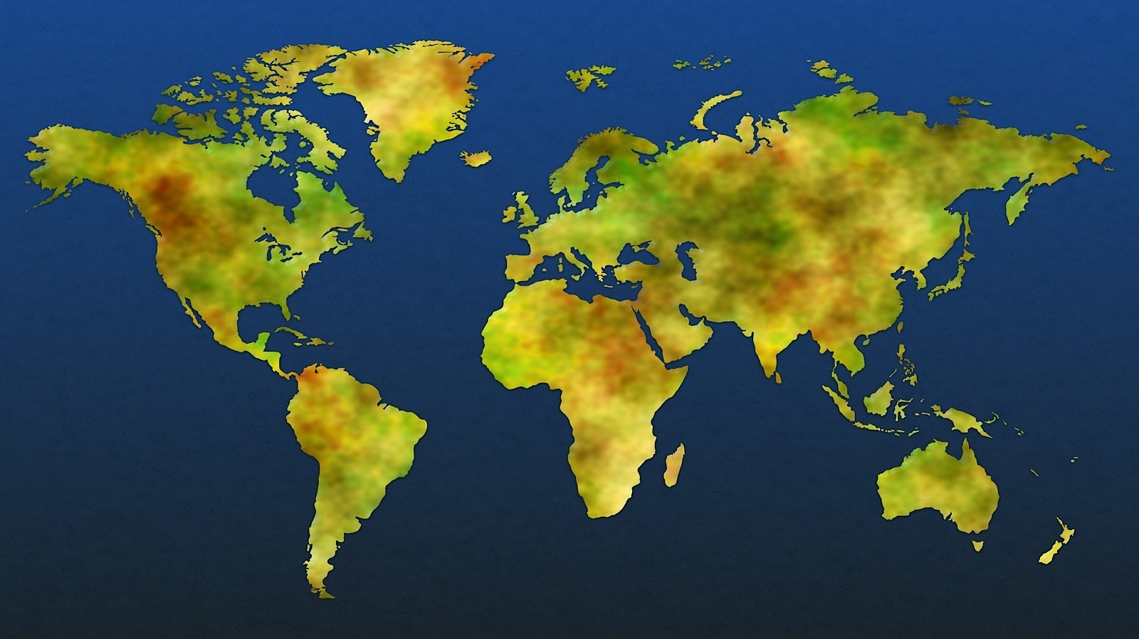



Datacenter security
Tools
Advanced workloads
Azure Stack + Hybrid
Core infrastructure
Two-factor authentication with biometrics
Perimeter fencing
One defined access point
24x7x365 security operations
Verified single-person entry
Video coverage
Secure destruction bins
PERIMETER
BUILDING
2 Mil kilometers intra-datacenter fiber
72+
Tb per second
Backbone
54 Azure regions
100+ datacenters
Millions of servers
Inability to identify location of specific customer data
System check
Background check
Employee and contractor vetting
ACCESS APPROVAL
SERVER ENVIRONMENT
Notes:
72Tb per second of network bandwidth – 7000 HD blue ray DVD’s across the network every second
42 Azure regions now
We can deliver your data across millions of servers,
How does Microsoft decide where to put our datacenters – we take all of the elements of scale into account to ensure the entire ecosystem can support the growth of the cloud – atency
We are not an
Over 100 datacenters
42 announced Azure regions
## edge nodes reducing latency and getting customers on to our managed network faster
Global dark fiber network ensuring performance, QoS and resilient connectivity
How do we select datacenter locations?
Proximity/Latency to customers (opportunity)
Energy (and climate/pue)
Network
Workforce (both operation and construction)
Hyperscale (emphasis on scale)
Only a few companies have the business need and opportunity to operate computing at a scale where you are no longer an IT shop, but a global infrastructure supply chain. The servers and network hardware become commodities and the special sauce is in the planning, execution and optimization of the service –managing the illusion of infinite capacity.
Global operations
This takes knowing how to operate around the globe, something that Microsoft has great experience in. We have operated international datacenters and networks for over 20 years and continue to grow our footprint outside the US. This is another cog in the supply chain – standing up new infrastructure, offerings and business models – operating ourselves or through partners in locations like China and Germany
Automation
Watching screens and waiting for alerts or emails is not sufficient at our scale. We have had to become experts at automation - Some of our datacenter campuses are two miles (3km) long – software can react to a problem much faster than a human can
Open Infrastructure
Pretty exciting that Microsoft is making a name for itself in the open source community lately. This includes our infrastructure – we have been a key part of Open Compute since 2014, starting with our Open Cloud Server design that underpins Azure and many other services at Microsoft. More recently, we shared the concept of our next generation hardware platform, Project Olympus, with OCP in 2016 and engaged with the community to tweak, improve and evolve the design to have even broader applicability and reach for many more companies.
On the network front, Microsoft contributed a linux based solution called SoNIC to OCP which make it easier to take advantage of new hardware capabilities in SDN implementations with common APIs and development frameworks.
Resilient Services
Wrapped around all of this infrastructure is a culture of development and operation that values building services that are not only ‘available’ but also resilient. At the scale we operate, one in a million events happen with surprising regularity. Our services are designed with this in mind so that when failures do occur, software can route around the issue and self heal.

Slide 25




































Compliance certifications
Tools
Advanced workloads
Azure Stack + Hybrid
Core infrastructure
GLOBAL
ISO 27001
ISO 27018
ISO 27017
ISO 22301
SOC 1 Type 2
SOC 2 Type 2
SOC 3
CSA STAR
Self-Assessment
CSA STAR
Certification
CSA STAR
Attestation
INDUSTRY
PCI DSS
Level 1
CDSA
MPAA
FACT UK
Shared
Assessments
FISC Japan
HIPAA / HITECH Act
HITRUST
GxP
21 CFR Part 11
MARS-E
IG Toolkit UK
FERPA
GLBA
FFIEC
REGIONAL
Argentina PDPA
EU
Model Clauses
UK
G-Cloud
China
DJCP
China
GB 18030
China
TRUCS
Singapore
MTCS
Australia
IRAP/CCSL
New Zealand
GCIO
Japan My
Number Act
ENISA
IAF
Japan CS Mark Gold
Spain
ENS
Spain
DPA
India
MeitY
Canada
Privacy Laws
Privacy
Shield
Germany IT
Grundschutz
workbook
Notes:
Compliance and trust is not an afterthought at Microsoft.
We are leaders in this space, and help set standards for global and federal organizations around the world.
Microsoft has been talking about trust in the cloud for a while and will continue to do so.
This is only a sampling of our compliance certifications, but we run the gamut.
Azure’s strengths are around security, privacy, and transparency around how we run the cloud.

Slide 26
Azure products
AI + Machine Learning
Management Tools
Storage
Get secure, massively-scalable cloud storage for your data, apps, and workloads
Analytics
Media
Compute
Microsoft Azure Stack
Storage Durable, highly available, and massively scalable cloud storage | Blob Storage REST-based object storage for unstructured data
Archive Storage Industry leading price point for storing rarely accessed data | Queue Storage Effectively scale apps according to traffic
File Storage File shares that use the standard SMB 3.0 protocol | Disk Storage Persistent, secured disk options supporting virtual machines
Data Lake Store Hyperscale repository for big data analytics workloads | Data Box Secure, ruggedized appliance for Azure data transfer
Storage Explorer View and interact with Azure Storage resources
Containers
Migration
Databases
Mobile
Developer Tools
Networking
DevOps
Security
Identity
Storage
Integration
Web
Internet of Things
* Preview Services
http://azureplatform.azurewebsites.net/

Slide 27
Azure products
AI + Machine Learning
Management Tools
Web
Build, deploy, and scale powerful web applications quickly and efficiently
Analytics
Media
Compute
Microsoft Azure Stack
Web Apps Quickly create and deploy mission critical web apps at scale | API Management Publish APIs to developers, partners, and employees securely and at scale
Content Delivery Network Ensure secure, reliable content delivery with broad global reach | Azure Search Fully-managed search-as-a-service
Azure SignalR Service Add real-time web functionalities easily
Containers
Migration
Databases
Mobile
Developer Tools
Networking
DevOps
Security
Identity
Storage
Integration
Web
Internet of Things
* Preview Services
http://azureplatform.azurewebsites.net/

Slide 28
Any Platform Any Language
Tools
Advanced workloads
Azure Stack + Hybrid
Core infrastructure
Notes:
Getting started in the cloud can be hard, but not when you have the help of others. Leverage the incredible power of our azure marketplace and have innovation of thousands of partners and companies at your fingertips. Don’t start it all alone, leverage the scenarios in the azure solutions and start with a basic reference of how to get things done. Need a specific solution.
It’s everything you need in a complete solution—from technical documentation to partner resources. Get started quickly with solutions that customers like GE Healthcare, 3M, and Rolls-Royce already trust.
Azure solution architectures
Architectures to help you design and implement secure, highly-available, performant and resilient solutions on Azure.
Azure roadmap
As Azure continues to grow, we want to keep you informed—so that we can plan for the future together. This product roadmap is the place to find out what’s new and what’s coming next. Let us know what you think by providing feedback and voting on items. You can also subscribe to notifications, so you’ll always be the in the know.

Slide 29
Open Source

Slide 30

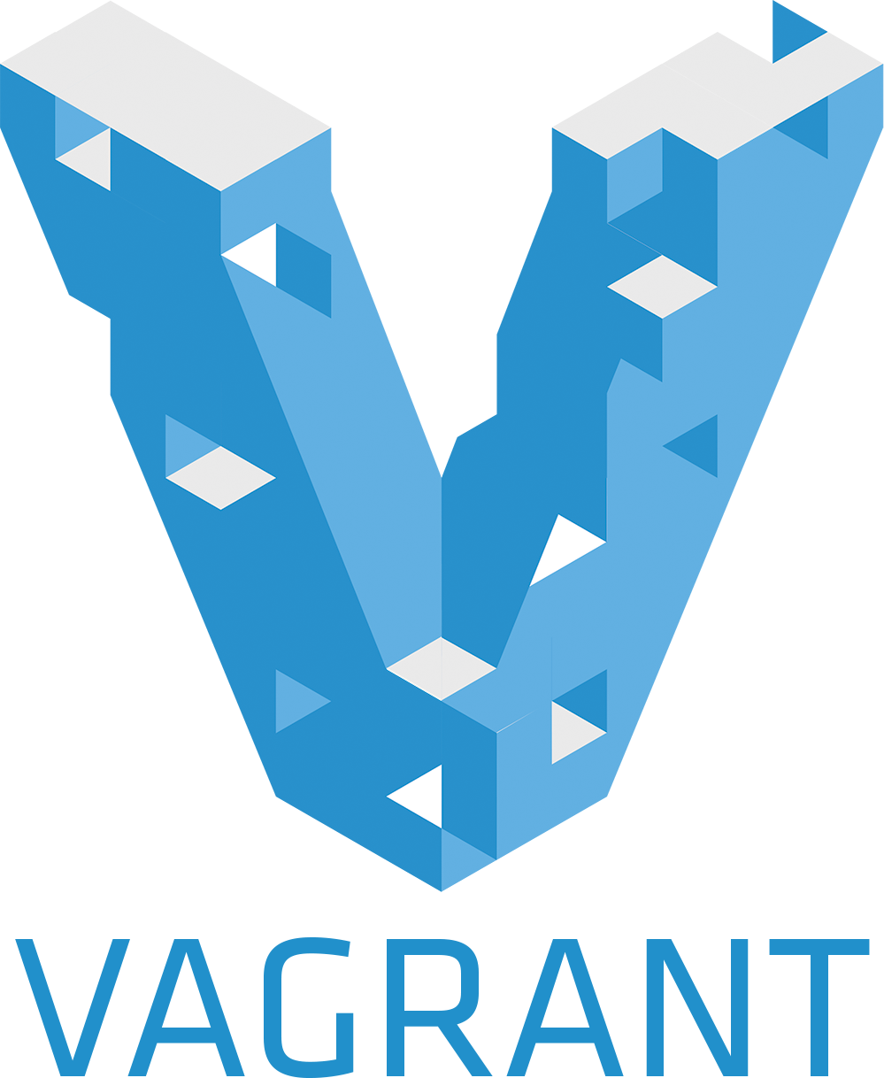





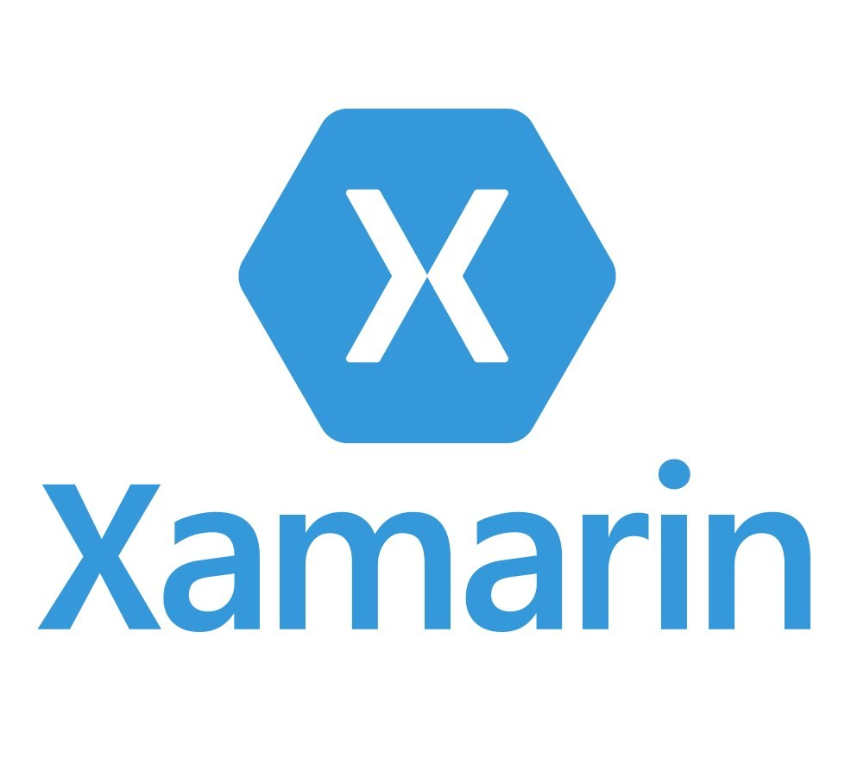
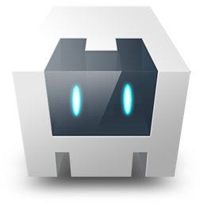


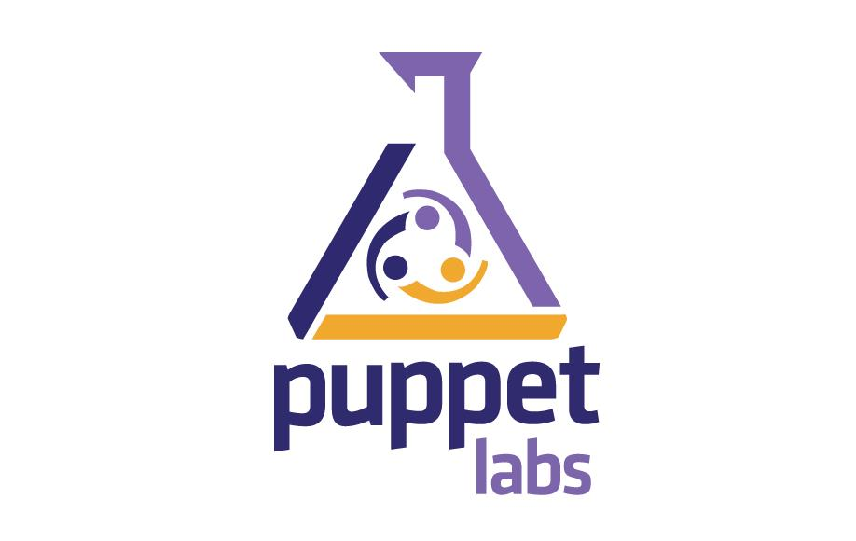

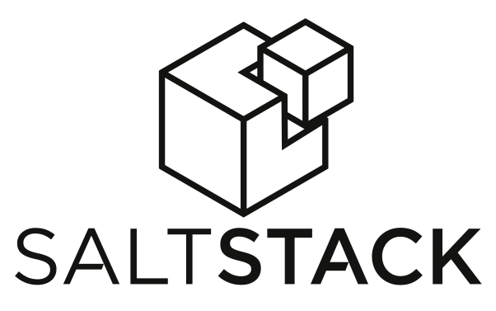



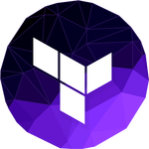

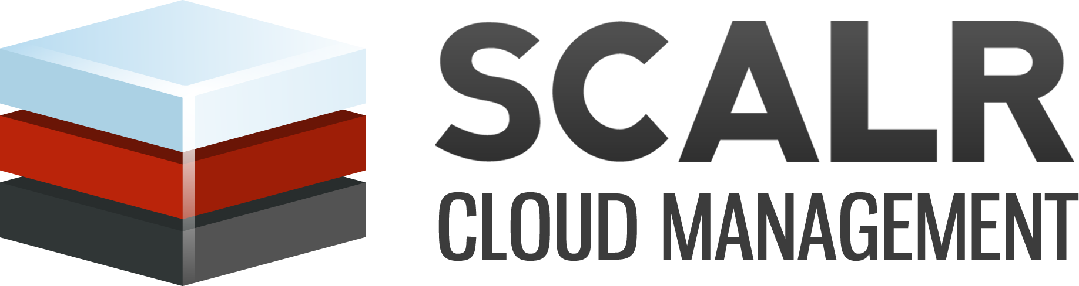
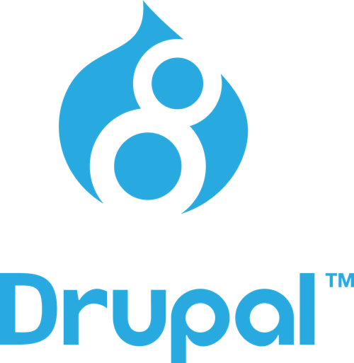


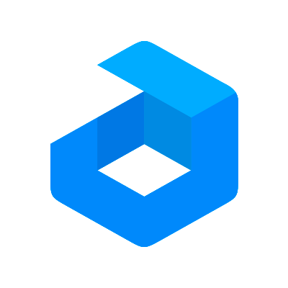



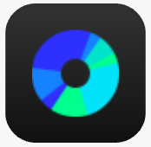









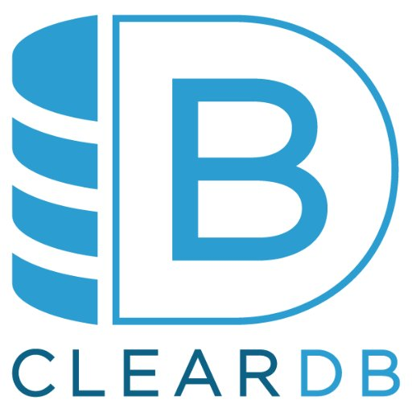
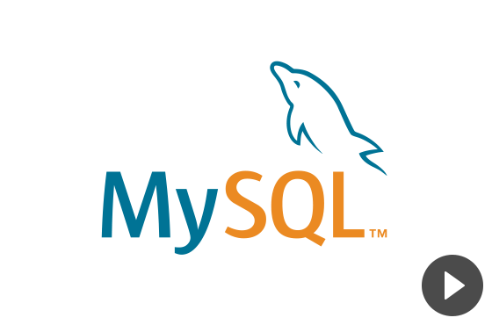

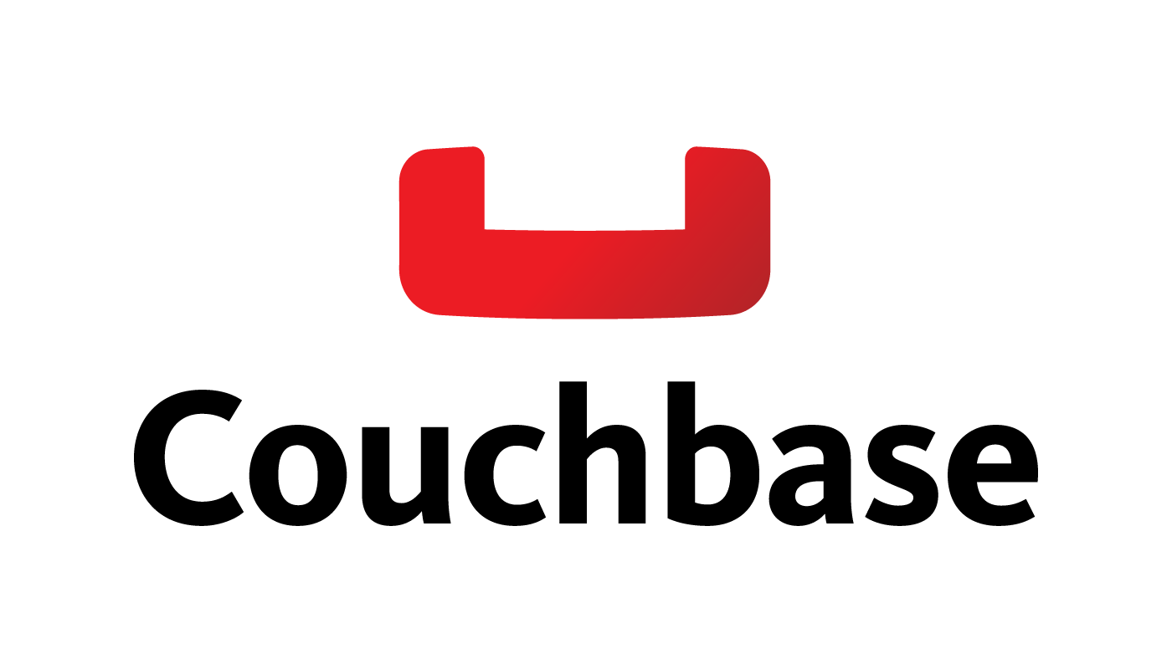






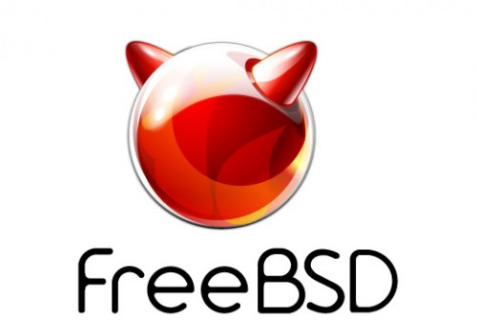



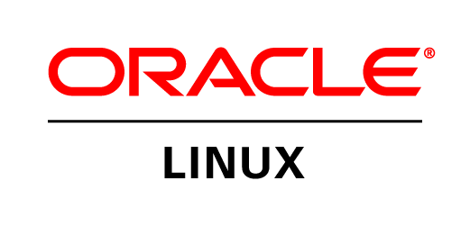
Open source support
Tools
Advanced workloads
Azure Stack + Hybrid
Core infrastructure
DevOps
Management
Applications
App frameworks
and tools
Databases and
middleware
Infrastructure
Notes:
Microsoft has a comprehensive approach to open source in the cloud that spans enabling, integrating, releasing and contributing to open source, with a strong emphasis on ecosystem partnerships
Microsoft Azure is an open and flexible cloud that is all about choice, and allows you to build applications in the cloud the way you want with your choice of tools, applications and frameworks
Microsoft also integrates open source into many of Azure products and services, such as Hadoop and Linux in HDInsight, fluentd in OMS or DC/OS, Kubernetes and Docker Swarm in ACS, and has open sourced ACS-Engine

Slide 31

Azure
Open Source
Notes:
Hiring – each and every new technical hire needs to have OSS skills…
Get comfortable, get fluent
Please communicate this to your teams

Slide 32
GitHub contributions
2018
VSCode ranked #1 developer tool (Stack Overflow, 2018 language survey)
Service Fabric Open Sourced
Azure Sphere with Linux kernel
GitHub intent to acquire announced
~5,000 Microsoft employees committing to open source projects on Github
Azure trending to 50% Linux
2017
Microsoft Azure Kubernetes Service launched
Draft, Brigade, Kashti projects submitted to Kubernetes community
Microsoft joins Cloud Native Computing & Cloud Foundry Foundations
Azure Database for Postgres & MySQL announced
Azure Databricks (Apache Spark) announced
2016
.NET Core 1.0
PowerShell Core
SQL on Linux announced
Windows Subsystem for Linux in Windows 10
Microsoft joins Linux foundation
2015
VSCode released
HDInsight (Hadoop/ Ubuntu) announced
Microsoft jointly forms Node.js foundation
2014
Satya “Microsoft loves Linux”
.NET foundation created
95,539
314,546
601,886
778,871
314,970 (YTD)
2014
2015
2016
2017
2018

Slide 33
Azure Monitor

Slide 34

Azure Monitor
Full observability for your infra, app and network
Metrics
Log
Common Store
Unified monitoring
A common platform for all metrics, logs and other monitoring telemetry
Data driven insights
Advanced querying and analytics powered by machine learning capabilities
Partner integrations
Rich ecosystem of popular DevOps, issue management, SIEM, and ITSM tools
Azure Monitor now includes Application Insights & Log Analytics!
Notes:
With Azure Monitor, our goal is to provide end to end monitoring for your application. To accomplish that, we provide a common backend and analytics platform that is built into Azure and all Azure services uses. What it means is out of the box near real time monitoring data all collected and consolidated in a single platform.
What we can then do with the data is to provide you end to end insights. Whether you have a problem with your application code, or a VM that is deployed to or the underlying network – you get a birds eye view and drill downs that help you isolate and quickly fix issues with a modern cloud application.
You may be thinking about your own monitoring tools. We understand that monitoring is not done in isolation. You have your DevOps, incident management, SIEM tools that you currently use – and want to continue using. Azure Monitor provides tight integration with popular tools. In addition, we provide API’s, SDK’s and webhooks to build your own custom integration.

Slide 35

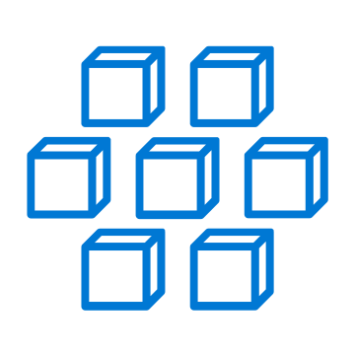
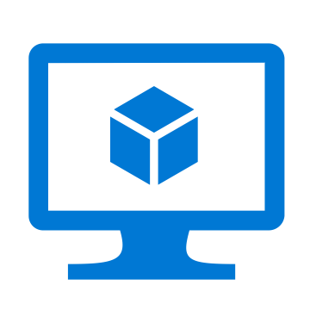
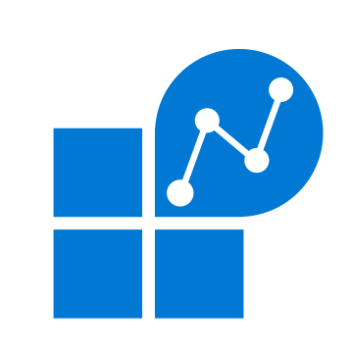
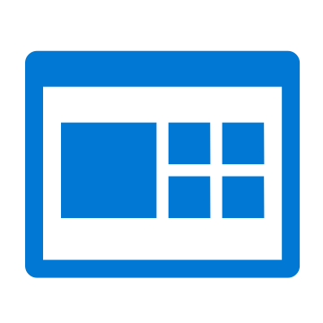




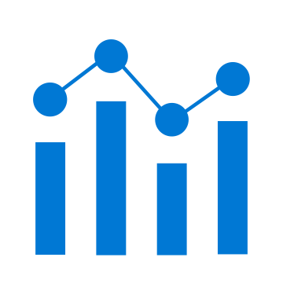
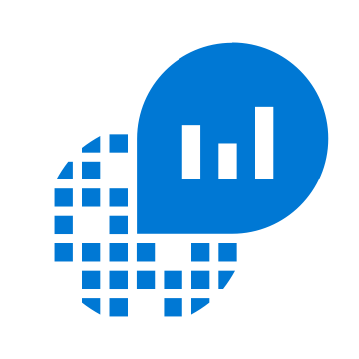




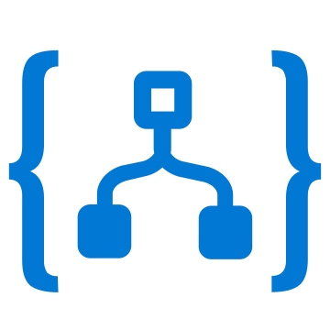

Azure Monitor
Insights
Application
Container
VM
Monitoring Solutions
Application
Operating System
Visualize
Metrics
Dashboards
Views
Power BI
Workbooks
Azure Resources
Azure Subscription
Analyze
Logs
Metrics Explorer
Log Analytics
Azure Tenant
Respond
Custom Sources
Alerts
Autoscale
Integrate
Event Hubs
Logic Apps
Ingest & Export APIs
Notes:
Here’s a conceptual overview of Azure Monitor. From left to right:
Azure Monitor captures monitoring telemetry from a number of sources. Some of these are Azure specific but others are generic – such as app and OS information from VMs. In addition, you can also inject data from custom sources.
The telemetry is stored in metrics and logs stores that is centralized, fully managed and optimized for cost and performance.
With all the data in one place, Azure Monitor provides a number of value-adds on top of it.
You can get the end to end insights that we discussed earlier. It could be for canonical use cases for monitoring applications, container, VM or networks. In addition, we have a range of Monitoring solutions such as SQL analytics for specialized workloads. The idea here is that as a customer, for most of your use cases, you get out of the board monitoring and diagnostics with little to no instrumentation
Alternatively, hyou can choose to

Slide 36
Partner Integrations

Slide 37

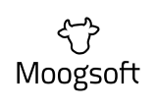














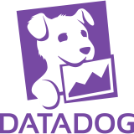

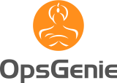
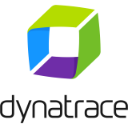
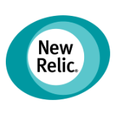

Integration with Monitoring & SIEM Tools
Azure Monitor is best for Azure, and provides both APM & SIEM capabilities
Open and extensible to continue using your favorite tools & solutions
Integrate your existing APM/Monitoring solutions with Azure Monitor
Route telemetry to your SIEM solutions for analytics & security management

Slide 38
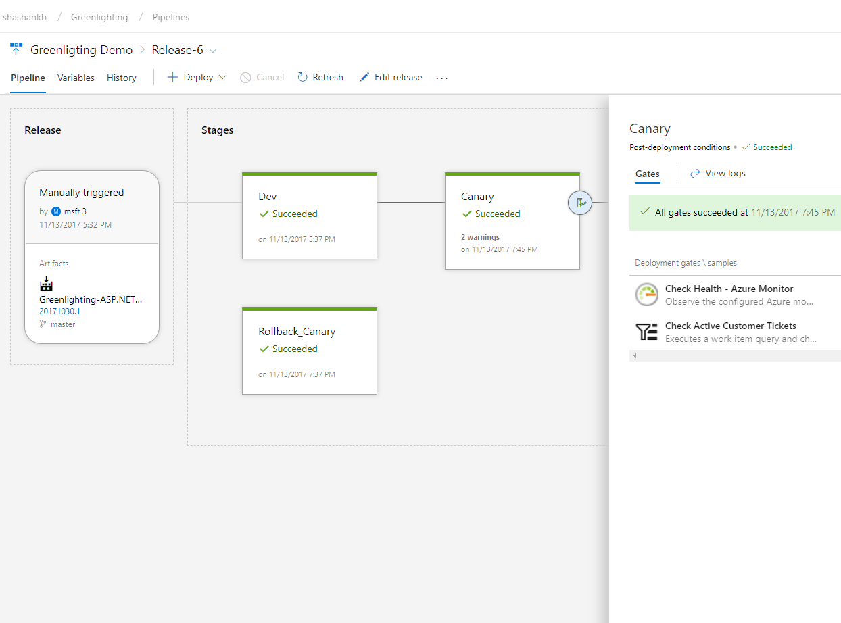
Continuous Monitoring for DevOps
Native IDE integrations in VS (.NET) and VS Code (Node.js)
Onboard with Azure Pipelines Release Management & DevOps Projects
Configure Pre- or Post-Deployment Quality Gates in Azure Pipelines
Run Load Test or Multi-Step Web Test for Synthetic Perf Monitoring
Work Item Management with Azure Boards for filing bugs and tracking
Alerts & Notifications with automated actions & ITSM integrations

Slide 39




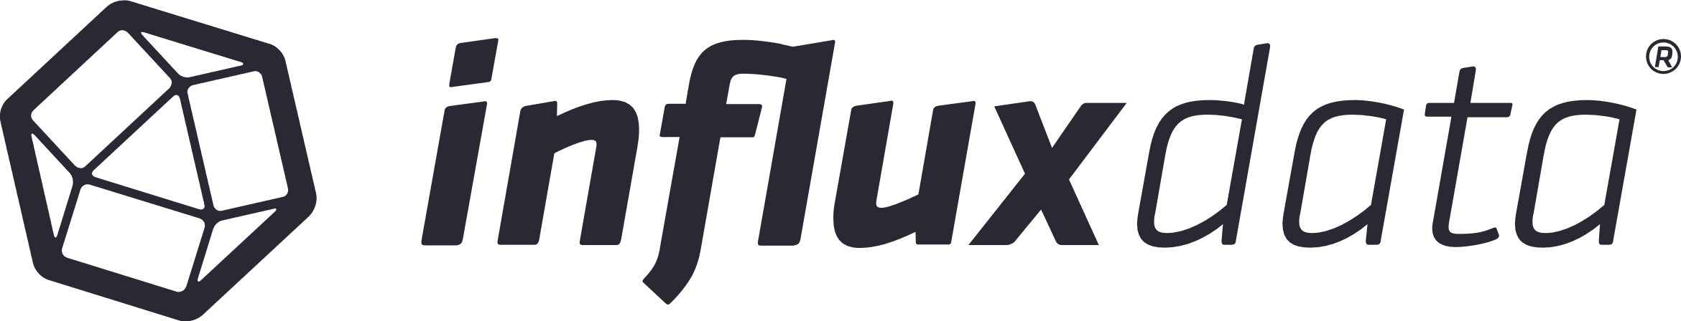
Partner solutions for Apps & Workloads
ISVs / MSPs / SIs are extending and building solutions on top of Azure Monitor for specific scenarios & workloads
Some solutions help monitor diverse technologies deployed on Azure
Apache, Citrix NetScaler, F5 SLB, SAP Hana, Oracle, etc.
Others use their proprietary technologies to provide deeper scenario specific insights or diagnostics workflows

Slide 40
DEMO ? Unless I am overtime and Alistair Moans

Slide 41
Azure Automation

Slide 42
Azure cloud management platform
GOVERN
SECURE
Policy Management
Cost Management
Security Management
Threat Protection
CONFIGURE
Microsoft Azure
PROTECT
Configuration
Update management
Automation
Scripting
Backup
Disaster Recovery
MONITOR
App, Infra, & Network Monitoring
Log Analytics and Diagnostics

Slide 43
Flexible automation platform
Management tools
Multiple options
Hybrid support
Central repository
Infrastructure as code
Operator role
PowerShell
Graphical
Python
Cross-platform
Hybrid worker
Single pane of glass

Slide 44
Scenarios for Azure Automation
Deployment
Operate
In-Guest
Pre / Post actions in ARM deployment
Create Azure AD / O365 accounts
Deploy on-premises resources
Azure SQL Tasks
Start / Stop test / dev VMs
Process alerts
Controlled actions on VM
No inbound ports open
Windows / Linux

Slide 45
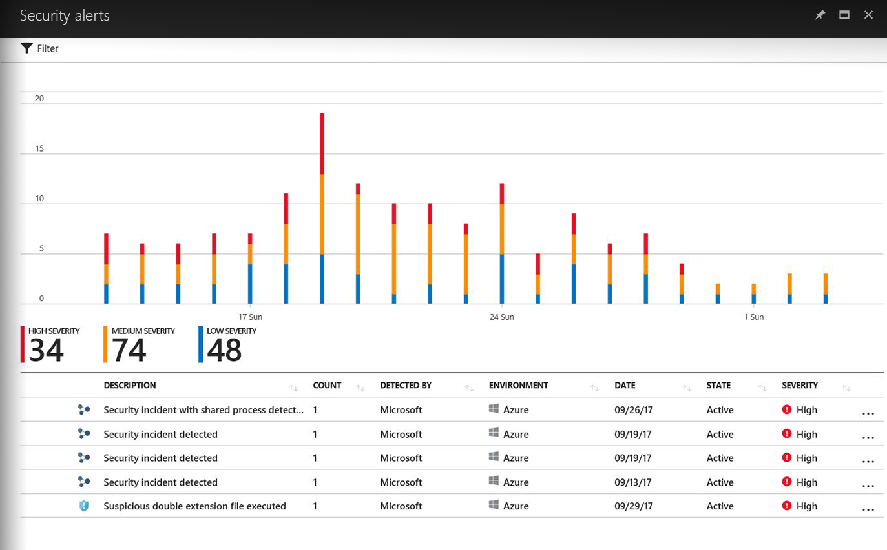
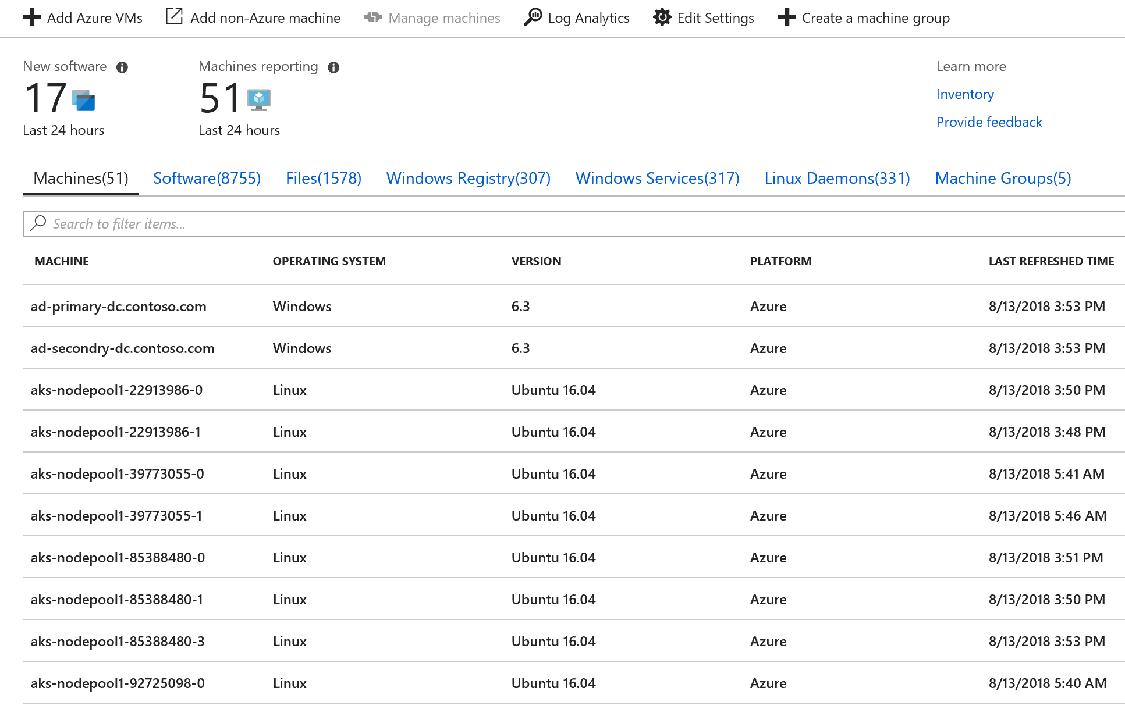
Inventory Discover the state of your environment
Inventory
Discover what's installed on your machines
Software
Services/Daemons
Files
Registries
View how many machines have a specific software or version
Updated when a change is detected
Notes:
Inventory
Collect & search inventory and history
Available for both Windows & Linux
Windows
Software
Services
Files
Registry
Linux
Software (Packages)
Daemons
Files
What do I have? Has it changed?
Focus on identifying configuration and assisting root-cause analysis of your environment
Key Features
Spans across Windows and Linux
Identify all machines reporting a given configuration
Example: All machines with an outdated version of Chrome
Native integration for Azure VMs
No additional cost for Azure VMs
Access straight from the VM resource page

Slide 46
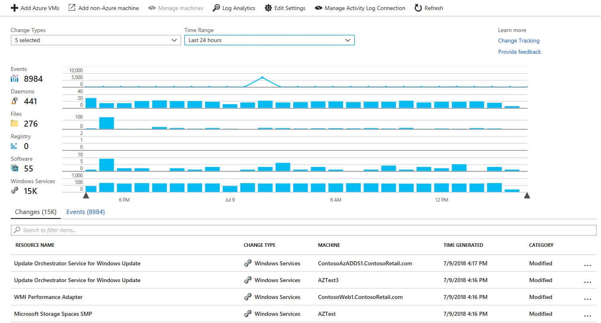
Change Tracking Detect server changes
Change Tracking
Detect changes to your machines
Software
Services/Daemons
Files
Registries
View changes when troubleshooting
Alert on critical changes
Difference in Inventory snapshots
Notes:
Change Tracking
Track changes made to your system
Valuable for root-cause analysis
Available for both Windows & Linux
Windows
Software
Services
Files
Registry
Linux
Software (Packages)
Daemons
Files
What do I have? Has it changed?
Focus on detecting drift and assisting root-cause analysis of your environment
Has a change brought you out of compliance?
Key Features
Spans across Windows and Linux
Create an alert based on changes to your configuration
Example: Trigger an alert if the IIS service is stopped
Native integration for Azure VMs
No additional cost for Azure VMs
Access straight from the VM resource page

Slide 47
Key Scenarios
Compliance
How many computers have a specific software or version installed?
Are all the installed applications expected?
Alerting
Was a new software installed?
Was a system critical service stopped?
Troubleshooting
Did someone change the configuration file?
Was a defining registry value modified?

Slide 48
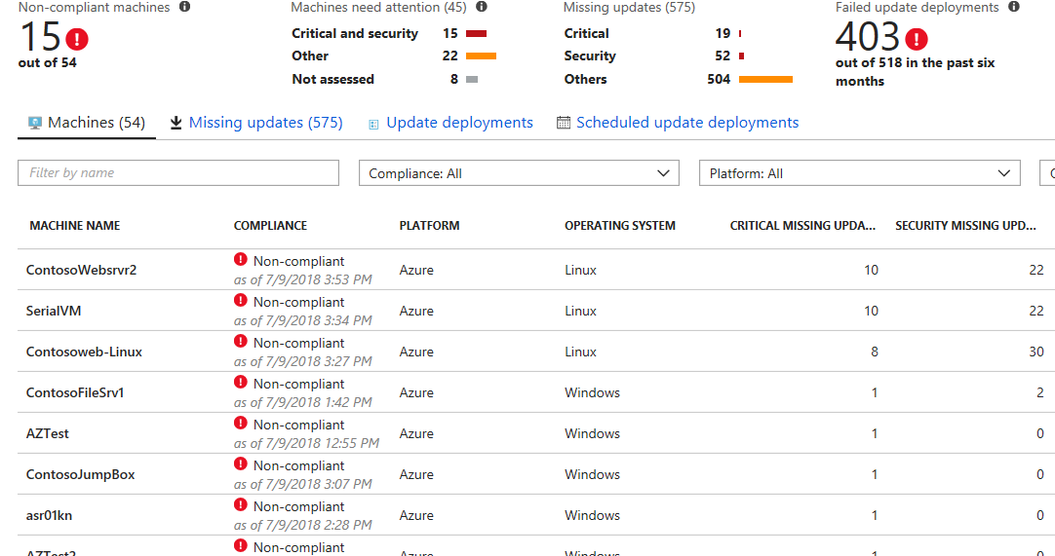
Update Management Assess & deploy server patches
Update management
Assess update status of servers across your environment
Deploy updates to your machines from a single pane of glass
Verify update compliance across your environment

Slide 49
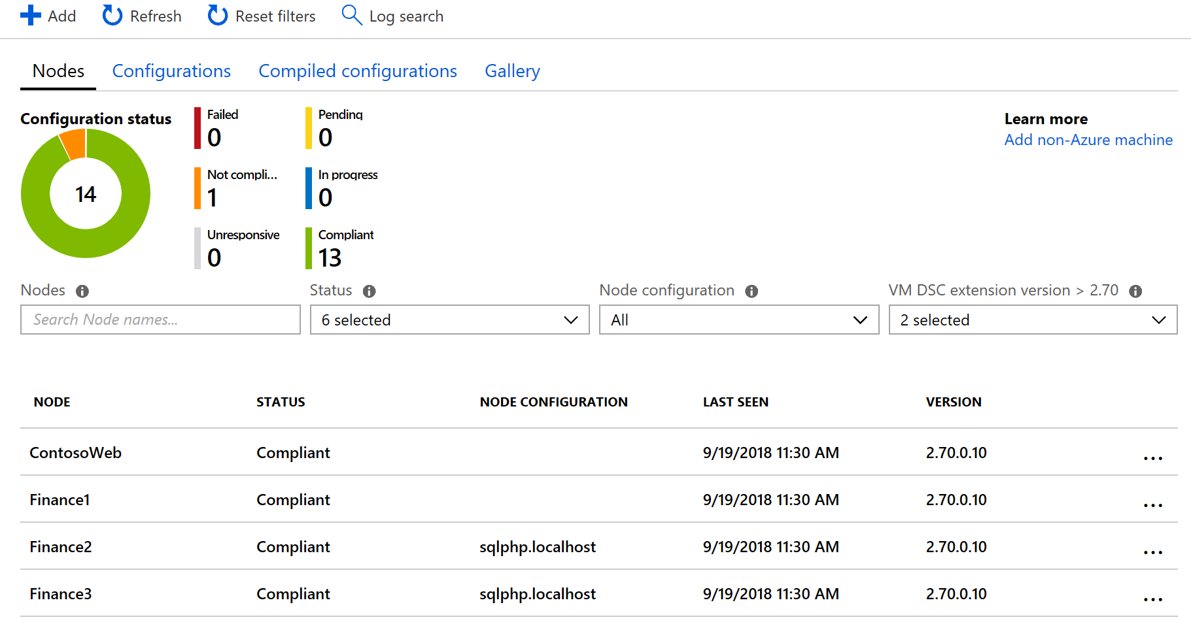
Configuration Management (DSC) Set and control your configuration as code
Configuration Management
Manage the configuration of your operating system and application settings
View compliance reports at scale from across your environment
Centrally store configurations and dependent modules
Notes:
Composable configurations
Community based repository
GUI for creating configurations
Devops configuration as code
Deploy, Monitor and Enforce
Rapid onboarding
At scale across your environment
Discover configuration drifts
Integrated with Azure Monitor

Slide 50
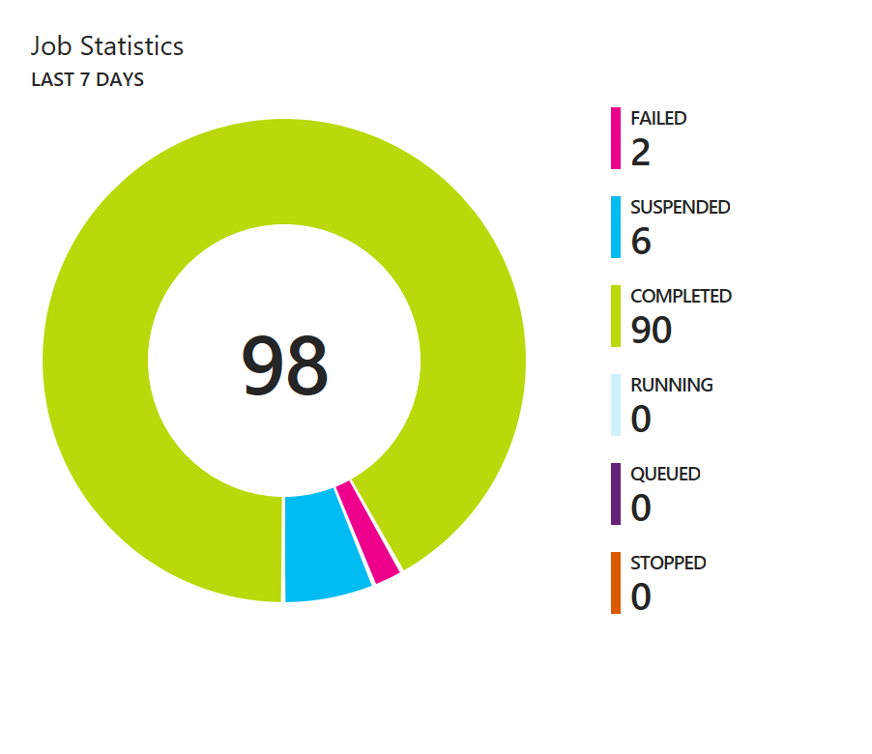
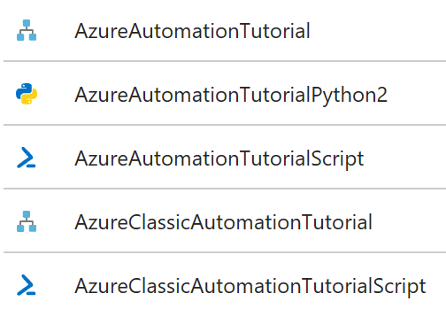
Processes Automation Automate redundant, error-prone processes
View job history
Built-in Microsoft-provided examples
Orchestrate tasks for your environment
Optimize consumption (Stop/Start VMs)
Cleanup and maintenance tasks
Runtime environment
Azure - using the automation service
On-prem - using on-prem machines
Deploy Python2 and PowerShell jobs
Deploy from the Azure portal, REST API, PowerShell Cmdlets, schedules, a webhook URL, Azure alerts, and more
Azure automation tutorials
Linux Python - Renew certificates
Windows – Renew password
Stop/Start VMs to minimize cost
Cleanup storage accounts

